Slide 1



Consumer Goods: Ad-hoc Insights
ATLIQ HARDWARE
- Vaibhav Bhople
PRESENT BY - VAIBHAV BHOPLE

Slide 2

Table of Content
Introduction
Business Scenario
Database Structure
Ad-hoc Requests
Recommendations

Slide 3
Introduction
Atliq Hardware, a top Indian computer hardware manufacturer, operates globally and It serves a diverse customer.
Notes:
Atliq Hardware is a leading computer hardware manufacturer based in India, renowned for its innovative solutions and robust global presence.

Slide 4
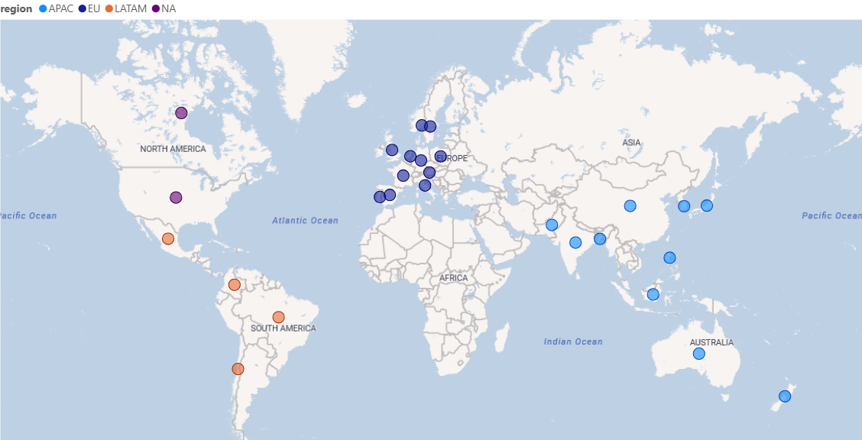
Atliq Hardware serves a diverse and expanding customer base all over world with 27 countries.
Notes:
With operations spanning 27 countries, Atliq Hardware serves a diverse and expanding customer base of 74 clients, making it a trusted partner across key markets in Asia Pacific (APAC), Europe (EU), North America (NA), and Latin America (LATAM).
Atliq’s success is also underpinned by its flexible and effective distribution strategy, with products reaching customers via three main channels: retailers, distributors, and direct sales.

Slide 5
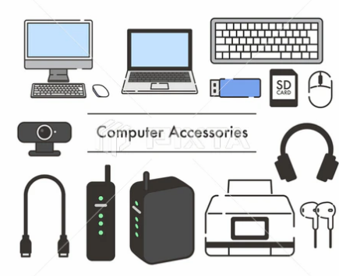

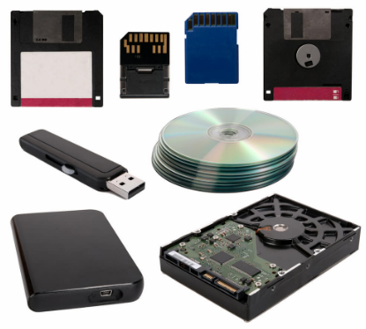
Atliq’s Product Line
Computer Peripherals and Accessories
Personal Computers
Networking and Storage devices
Notes:
The company prides itself on its extensive product portfolio, which includes three main divisions: Peripherals and Accessories (P & A), Network and Storage (N & S), and Personal Computers (PC). These divisions allow Atliq Hardware to offer a comprehensive range of high-quality products tailored to meet the varied needs of customers worldwide.
With a commitment to quality, innovation, and customer satisfaction, Atliq Hardware continues to be a prominent player in the global computer hardware market, providing cutting-edge solutions that meet the demands of an ever-evolving digital landscape.

Slide 6
Business Scenario
Provide insights to the management by solving Ad-hoc requests

Slide 7
Database Structure
Overview of Data:
The database covers two fiscal years: 2020 and 2021.
The fiscal year begins September 1st and ends August 31st.
With a total of six key tables, the structure is designed to give a comprehensive view of customer details, product information, pricing data, manufacturing costs, pre-invoice deductions, and monthly sales figures.
Notes:
Database Structure Overview
Atliq Hardware's database, Atliq_hardware_db, is designed to efficiently manage and store crucial business data.

Slide 8
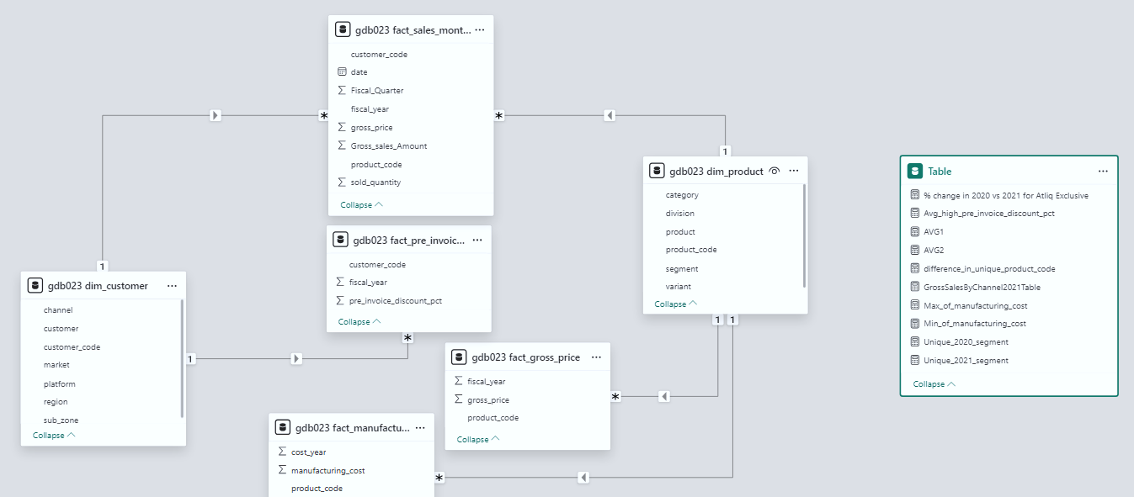
Input Data :
Atliq Hardware manages key business data across fiscal years 2020 and 2021, along with a different dimension table like product and customer details also 4 different Fact tables.
Notes:
dim_customer - Stores customer details (IDs, names, regions, etc.)
dim_product - Holds product information (IDs, names, categories, specs)
fact_gross_price - Tracks product gross prices and revenue
fact_manufacturing_cost - Records product manufacturing costs (materials, labor)
fact_pre_invoice_deductions - Details pre-invoice deductions like discounts
fact_sales_monthly - Tracks monthly sales data (units sold, revenue)
This structure enables Atliq Hardware to efficiently analyze customer, product, pricing, cost, and sales data, supporting informed decision-making and business growth.

Slide 9
Ad-hoc Requests
Ad – hoc Request, Queried Results, Insights and Visualizations

Slide 10
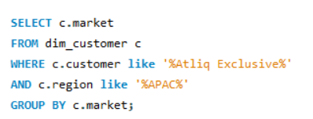
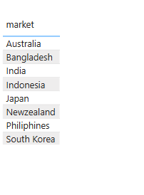
Request 1 :
Provide the list of markets in which customer "Atliq Exclusive" operates its business in the APAC region.

Slide 11
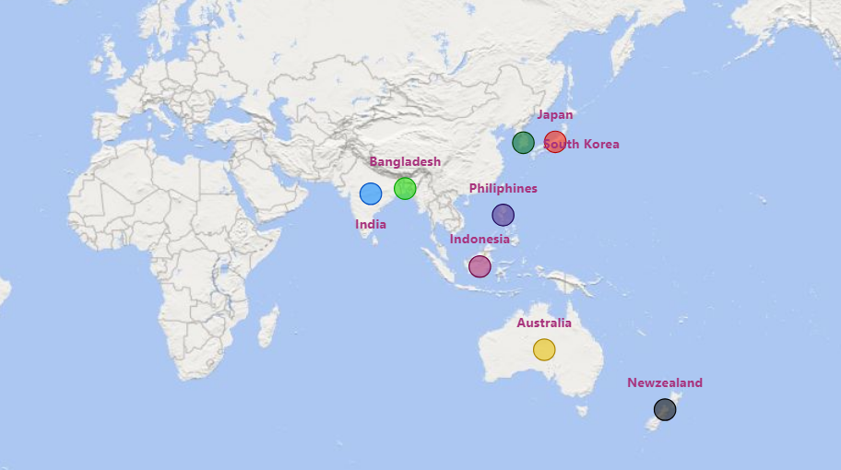
Insights:
These 8 countries represent the key markets where Atliq Exclusive has a presence, enabling its growth and business expansion across the Asia-Pacific (APAC) region.

Slide 12
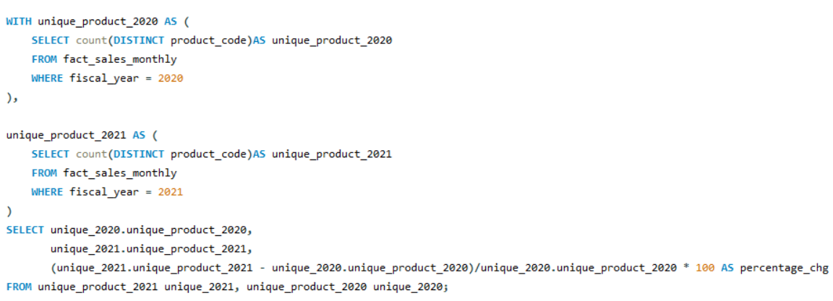
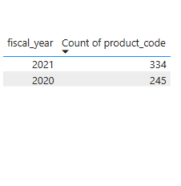
Request 2 :
Generate a report to see what is the percentage of unique product increase in 2021 vs. 2020?

Slide 13
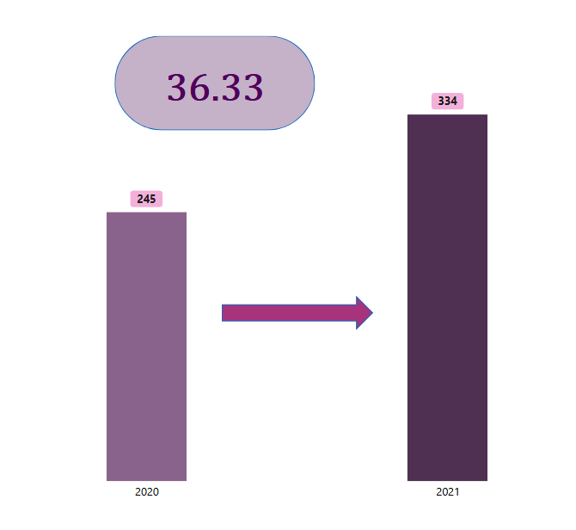
Insights:
Significant Growth: Atliq Hardware has experienced a notable increase in its product offerings, with a 36.33% growth in the number of unique products in 2021 (334) compared to 2020 (245).
Product Portfolio Expansion: This growth suggests a successful strategy in broadening the product portfolio, potentially responding to changing customer needs, market demand, or competitive positioning.
Future Outlook: The increase in unique products could indicate a focus on innovation and diversification, positioning Atliq Hardware for stronger market presence and higher customer satisfaction moving forward.

Slide 14
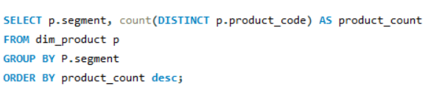
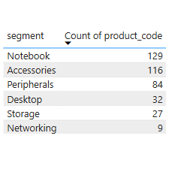
Request 3 :
Provide a report with all the unique product counts for each segment and sort them in descending order of product counts.

Slide 15
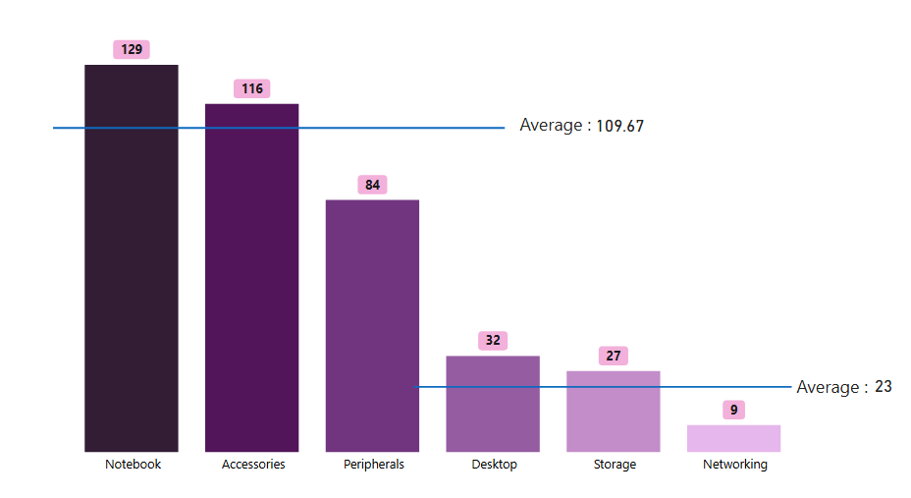
Insights:
Top Segments: The Notebook and Accessories segments dominate with 129 and 116 unique products, reflecting strong focus and demand in these categories.
Lower Segments: Storage (27) and Networking (9) have the fewest unique products, suggesting potential for growth or expansion in these areas.
This shows a clear product concentration in notebooks & accessories, with room to expand in other categories.
Product Focus: The average product count of the top three segments (109.67) is significantly higher than the bottom three (23), indicating a concentrated product offering.
Growth Opportunities: The low product counts in Desktop, Storage, and Networking suggest potential areas for strategic investment or market diversification.

Slide 16
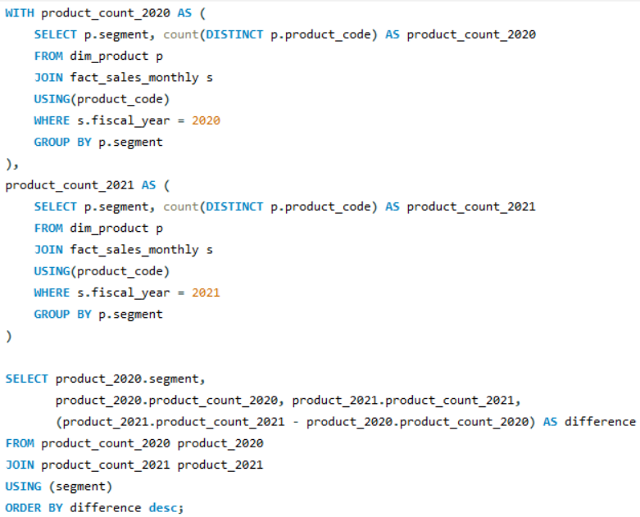
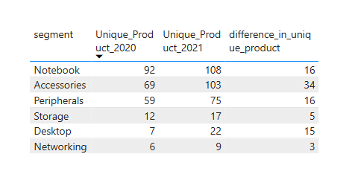
Request 4 :
Follow-up: Which segment had the most increase in unique products in 2021 vs 2020?

Slide 17
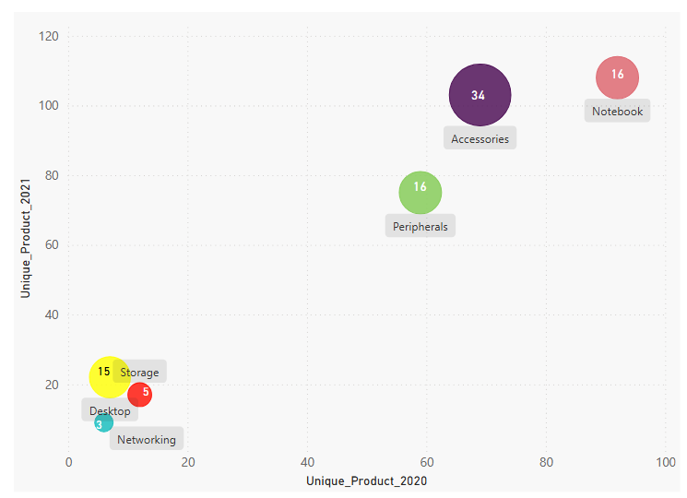
Insights:
Highest Increase: The Accessories segment experienced the largest increase in unique products, with a 34-product difference between 2021 and 2020. This indicates a significant expansion or improvement in this product category.
Moderate Increases: Other segments such as Notebook, Peripherals, and Desktop showed a more moderate increase, with 16 products each, suggesting steady growth in these categories.
Smaller Increases: Storage and Networking saw relatively smaller increases in unique products, with differences of 5 and 3, respectively, indicating limited growth in these areas.
This highlights that Atliq Hardware focused more on expanding the accessories range in 2021, with steady growth in other key segments.

Slide 18
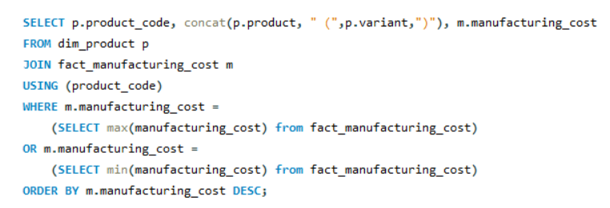
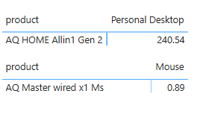
Request 5 :
Get the products that have the highest and lowest manufacturing costs.

Slide 19
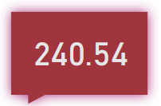
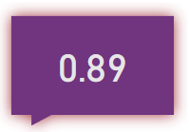


Insights:
The "AQ Master Wired X1" in the Mouse category has the lowest manufacturing cost at 0.89, while the "AQ HOME Allin1 Gen 2" in the Personal Desktop category has the highest cost at 240.54, reflecting the difference in complexity and components between peripheral devices and desktop systems.
AQ HOME Allin1 Gen 2
AQ Master wired x1 Ms
Personal Desktop
Mouse

Slide 20
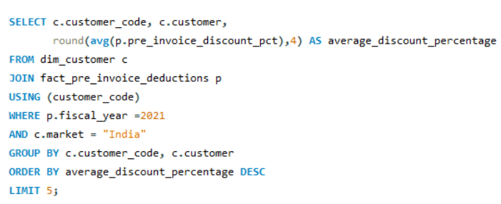
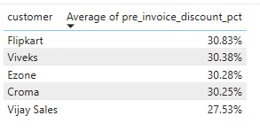
Request 6 :
Generate a report which contains the top 5 customers who received an average high pre_invoice_discount_pct for the fiscal year 2021 and in the Indian market.

Slide 21
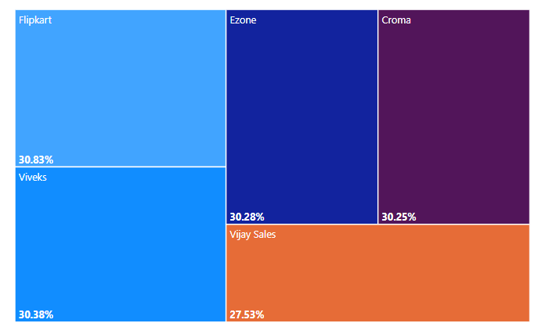
Insights:
Flipkart leads with the highest discount at 30.83%, followed closely by Viveks (30.38%), Ezone (30.28%), Croma (30.25%), and Vijay Sales (27.53%).
These high discounts reflect Atliq Hardware’s strategy of offering competitive pricing to major retailers and e-commerce platforms in India.
The discounts indicate strong business relationships with top customers, emphasizing volume-based sales and market penetration.
The small variations in discount percentages suggest a consistent pricing approach across key accounts.
Atliq’s strategy of providing high discounts likely aims to increase sales volume, strengthen market share, and maintain competitiveness in the Indian market.

Slide 22
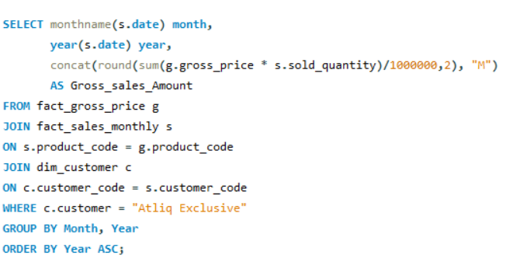
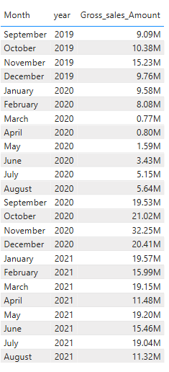
Request 7 :
Get the complete report of the Gross sales amount for the customer “Atliq Exclusive” for each month. This analysis helps to get an idea of low and high-performing months and take strategic decisions.

Slide 23
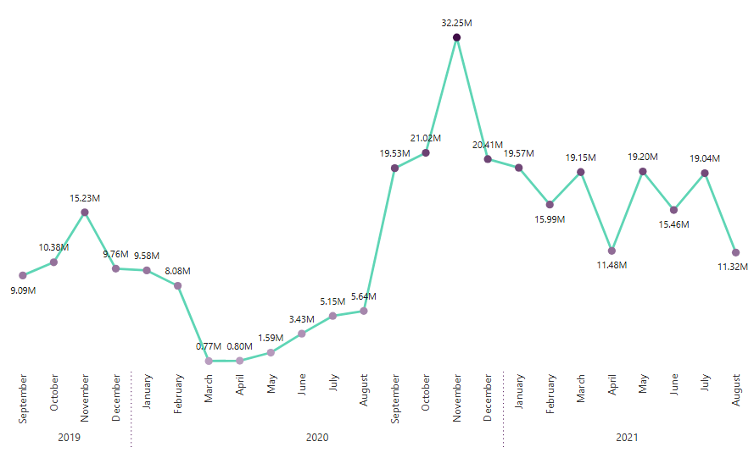
Insights:
The gross sales for Atliq Exclusive showed strong fluctuations across the years.
High-performing months were November and December in 2020, while April and May 2020 and August 2021 saw the lowest sales. Focus on leveraging peak months and investigating dips in low-performing months for future growth.
The company should focus on capitalizing during high-performing months, especially year-end periods.
It needs to address low sales months by investigating causes like market disruptions or seasonal factors.
Optimizing promotions, enhancing supply chain flexibility, and boosting customer engagement during slower months can drive growth.
Notes:
2019 was relatively stable, peaking in March (15.23M), while 2020 faced significant drops due to the pandemic but recovered sharply towards year-end, especially in November (32.25M). 2021 exhibited more consistency, with steady sales between $11M to $19M, peaking in January (19.57M).
While steady results in certain months show a solid foundation, there's potential for improvement in maintaining consistent sales throughout the year.

Slide 24
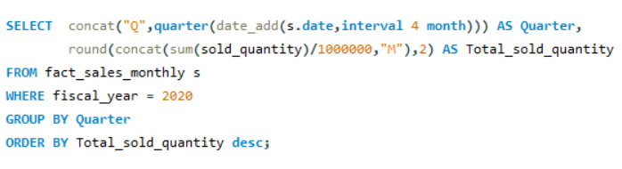
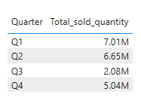
Request 8 :
In which quarter of 2020, got the maximum total_sold_quantity?

Slide 25
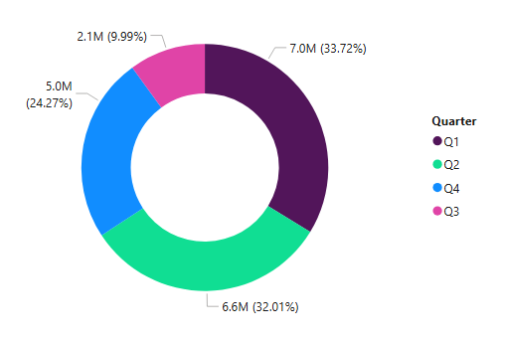
Insights:
Q1 and Q2 performed strongly, indicating that the company’s early-year strategies were effective.
The sharp decline in Q3 suggests there may have been external factors or market challenges that impacted sales, which should be investigated further.
Q4 demonstrated recovery, but the company should focus on boosting Q3 performance by analyzing potential causes of the drop and implementing corrective strategies.
To maintain growth, Atliq Hardware can consider reinforcing sales efforts in Q3 through targeted marketing or product adjustments, ensuring a more balanced performance across all quarters.

Slide 26
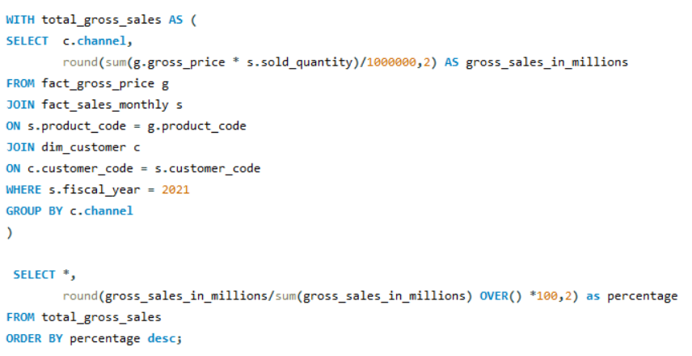
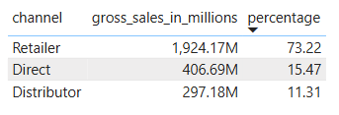
Request 9 :
Which channel helped to bring more gross sales in the fiscal year 2021 and the percentage of contribution?

Slide 27
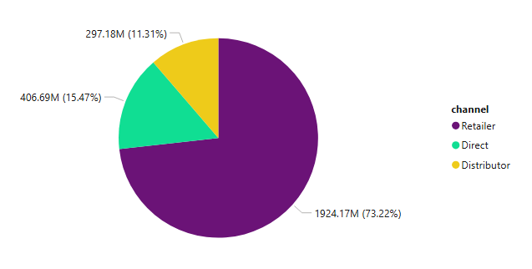
Insights:
In fiscal year 2021, retailers contributed the highest to Atliq Hardware's gross sales, accounting for 73.22% of total sales, amounting to 1924.17M. Direct sales followed with 15.47% (406.69M), and distributors contributed the least at 11.31% (297.18M).
Retailers played a dominant role in driving gross sales, indicating that the company’s retail strategy was highly successful and should continue to be a key focus.
The contribution from direct sales and distributors is relatively low, suggesting potential for growth in these channels.
Atliq Hardware could explore ways to increase sales through direct sales and distributors, possibly by enhancing relationships, improving incentives, or expanding market reach.
Notes:
The company should continue nurturing its strong retailer partnerships while looking for opportunities to diversify and boost sales through the other channels.

Slide 28
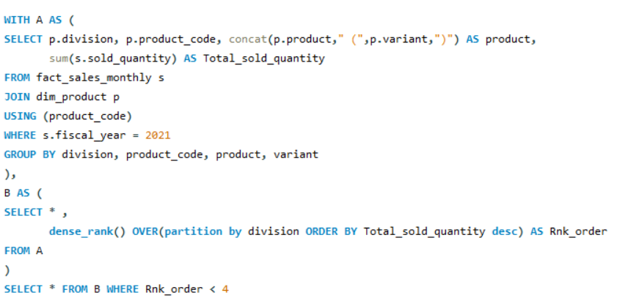
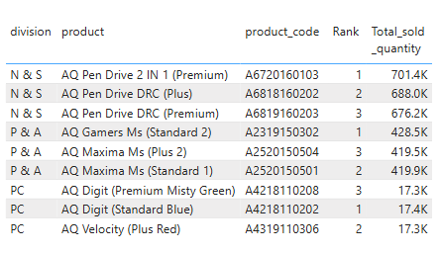
Request 10 :
Get the Top 3 products in each division that have a high total_sold_quantity in the fiscal_year 2021?

Slide 29
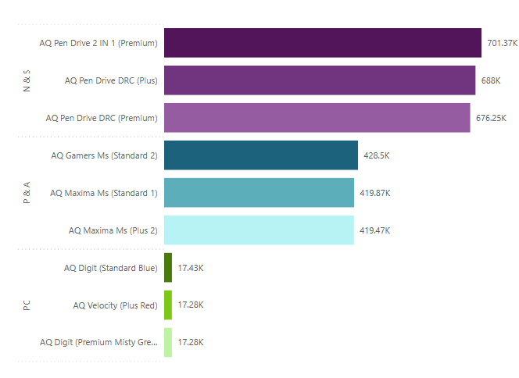
Insights:
In FY 2021, the Network and Storage (N&S) division was led by AQ Pen Drive 2 IN 1 (Premium) with 701.4k units sold.
The Personal Computers (PC) division had moderate sales, with AQ Digit (Standard Blue) and AQ Velocity (Plus Red) each selling around 17k units.
The Peripherals and Accessories (P&A) division excelled with AQ Gamers Ms (Standard 2) leading at 428.5k units sold.
Atliq Hardware should focus on expanding its successful pen drive and gaming peripherals lines. Additionally, there’s potential to grow the PC division through targeted marketing and product innovation.

Slide 30
Recommendations
Enhance Market Penetration
Product Diversification
Strategic Marketing
Cost Optimization
Customer Relationship Management
Sales Forecasting
Strategic Sales Focus
Product Performance Analysis
Notes:
▪ Enhance Market Penetration: Leverage insights from the analysis to expand operations strategically in
the APAC region, focusing on high-potential markets.
▪ Product Diversification: Capitalize on the observed growth in unique products by continuing to diversify
the product portfolio, especially in high-performing segments like Accessories.
▪ Strategic Marketing: Utilize segment-wise product counts and unique product increase insights (Q4) to
tailor marketing strategies for each segment.
▪ Cost Optimization: Review products with the highest manufacturing costs for cost optimization
opportunities, ensuring competitiveness in the market.
▪ Customer Relationship Management: Maintain strong relationships with top customers identified in the
analysis, potentially exploring loyalty programs or exclusive offerings.
▪ Sales Forecasting: Use monthly gross sales data and identify seasonal trends for more accurate sales
forecasting, aiding in inventory management.
▪ Strategic Sales Focus: Based on the channel contribution, strategically prioritize sales efforts with
retailers and direct channels for maximum impact.
▪ Product Performance Analysis: Regularly analyze the performance of top products in each division to
adapt to changing market demands and consumer preferences

Slide 31
THANK YOU
- VAIBHAV BHOPLE

